Slide 1
PSYCHOLOGICAL FIRST AID
Getting through trauma together….
Notes:
This power point training unit is divided into three modules that can be done in approximately 15 minute segments. There are quiz questions at the end of modules 1 and 2 and a learning activity at the end of module 3. The total unit should take between 50 and 60 minutes. There are also two handout that are optional. One references the common reactions to disaster – related stress, and one is a wallet card format with the core actions of psychological first aid.

Slide 2
OBJECTIVES
Understand the psychological impact of disasters and recognize the common reactions in self and others.
Define the goal and core actions of Psychological First Aid (PFA).
Prepare to provide immediate support to residents and co-workers experiencing disaster-related stress.
Notes:
Psychological First Aid (PFA) is an evidence-informed approach that is built on the concept of human resilience. PFA aims to reduce stress symptoms and assist in a healthy recovery following a traumatic event, natural disaster, public health emergency, or even a personal crisis.

Slide 3
STRESS AND DISASTERS
MODULE I
Notes:
Emotional distress is not always as visible as a physical injury, but is just as painful and debilitating. Everybody who experiences a disaster is touched by it
Reactions manifest differently at different periods of time during and after the incident.

Slide 4
WHAT IS A “DISASTER”? Wide - scale emergency events that have a severe impact on a community
DISASTERS -
Traumatize large populations of people at once
Can result in epidemics of survivor guilt and other psychological symptoms
Create chaotic environment
Multiple stressors
A smaller event that impacts just one household or person can be a disaster for the survivors
Notes:
Even a personal crisis can produce extreme stress for an individual. These techniques don’t have to be reserved for use only in a disaster situation.

Slide 5
IMPACT OF DISASTERS
For a community – depletion of resources and slow recovery
For people –
Everyone who experiences a disaster is affected in some way – Even the helpers!
People pull together
Stress and grief are common reactions to uncommon situations
Notes:
A disaster is an emergency that overwhelms the available resources. This can be a community wide event, but also an individual crisis.

Slide 6
REACTIONS
Some people will have severe reactions following a disaster event
Most people recover without professional treatment
Survivors often to do not seek or accept help, especially from helpers from outside the community
Notes:
Emotional distress is not always as visible as a physical injury, but is just as painful and debilitating.
After going through a life altering experience it is common to be effected emotionally.

Slide 7
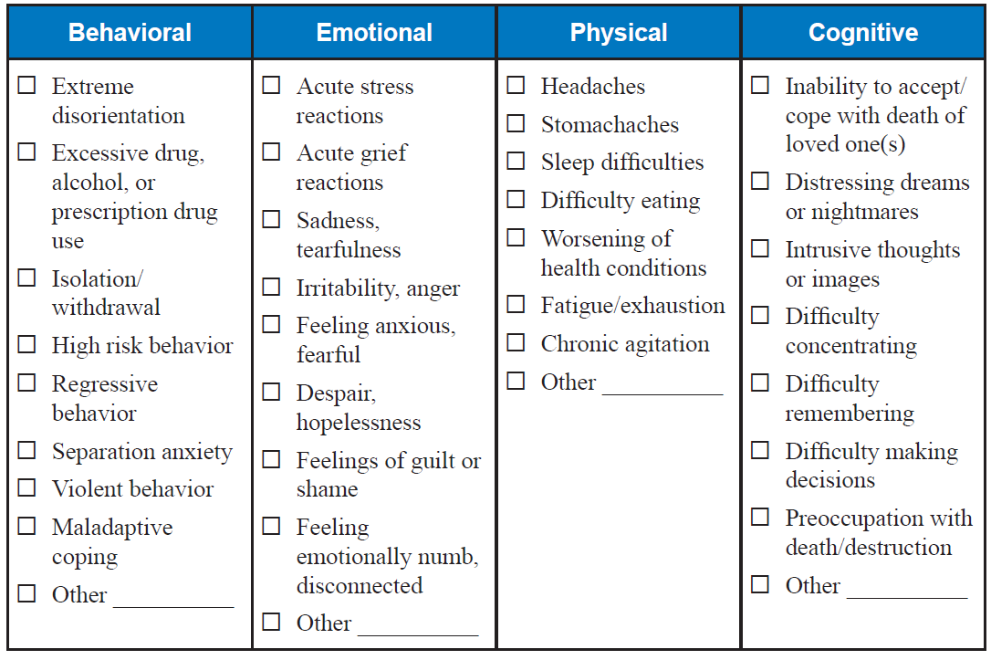
COMMON REACTIONS TO DISASTER STRESS
Notes:
A person could suffer some or all of these reactions to disaster stress. They may come and go, and manifest at different times.

Slide 8
HOW LONG DO THESE THOUGHTS AND FEELINGS LAST?
Most people exposed to disasters recover fully from the psychological affects within one year
The most intense reactions will lessen over the first few weeks
If they persist over 4-6 weeks or are so bad they impair functioning then professional help is needed.
Notes:
The variables of the event and the resiliency of the person will influence the length of their emotional recovery. PFA can help by offering comfort initially and connecting the person to resources that can help long term.

Slide 9
FACTORS THAT MAY INDICATE THAT PROFESSIONAL HELP IS NEEDED “3 Rs”
REACTIONS – Severe confusion, impaired thinking, distress that cant be calmed, expressed thoughts of self harm or harm to others
RISK – Those that lost a loved one, were injured, believed they were going to die, or saw death of others, extreme community destruction
RESILIENCY- Lack good coping skills, has no family support, has experienced other recent traumas prior to the disaster
Notes:
PFA is not traditional psychiatric or professional mental health treatment, but rather a strategy to reduce stress reactions by providing additional support to those who have been affected by a traumatic or emergency incident.
While most people will recover on their own from a traumatic incident, some people may need more intensive or professional support services.
The factors that may indicate that someone will need professional help summarized in the “3 Rs” of the severity of the person’s reactions, the risk for extreme trauma due to the impact of the actual event, and the person’s history of coping, and major trauma prior to the event such as the loss of a loved one, major health or financial problems.

Slide 10
CHILDREN AND ELDERS CAN BE PARTICULARY SENSITIVE
To changes in their routine
Separation from familiar environments
Separation from familiar people
Watch for delayed reactions of several hours to a few days
Notes:
Psychological First Aid can help everyone—children, adolescents, adults, elders, families, and communities who have been exposed to a traumatic or emergency incident, including responders and support service providers.
Elders in long term care may be particularly stressed by an incident because they are already physically fragile, may have limited resiliency, and experience a sense of vulnerability or helplessness.
The stress of the actual event followed by changes in their care routine may take a toll on their health and well being as time goes on.

Slide 11
MODULE 1 QUIZ
1. All people are impacted by a disaster, even those that come to the area help others.
True/False
2. All people need professional mental health services after a disaster experience
True/False
Notes:
Key
True
2, False

Slide 12
MODULE 1 QUIZ (cont.)
3. Common reactions after a disaster include:
a. Feelings of guilt, anger, hopelessness or a loss of control.
b. Difficulty sleeping, remembering, or paying attention
c. Headaches, digestive problems, dizziness, tightness in chest
d. All of the above
4. What does the “3 Rs” stand for?
a. Reactions, Risk factors, Resilience factors
b. Respect, Reassurance, Regular factors
c. Routine, Respect, Rest factors
d. None of the above
Notes:
Key
3. d.
4. a.

Slide 13
PSYCHOLOGICAL FIRST AID
MODULE 2
Notes:
Psychological First Aid is tool that each of us can use to reduce our stress level. By understanding your stress reactions and utilizing Psychological First Aid principles, you can enhance resilience in yourself, your family, workplace, and community.

Slide 14
PSYCHOLOGICAL FIRST AID (PFA)
Is an approach that:
Eases suffering of disaster survivors: both physical and emotional
Improves survivors short term functioning
Promotes emotional recovery after a disaster event
Notes:
Psychological First Aid addresses basic needs and reduces psychological distress by providing a caring comforting presence, and education on common stress reactions. It empowers the individual by supporting strengths and encouraging existing coping skills. It also provides connections to natural support networks, and referrals to professional services when needed.

Slide 15
THE GOAL OF PFA
Is to promote an environment of:
Safety
Calm
Connectiveness
Self-reliance
Hope
Notes:
Psychological First Aid is designed to be simple and practical so that it can be used in any setting. Psychological First Aid can be provided anywhere that trauma survivors can be found - in long term health facilities, shelters, schools, hospitals, private homes, the workplace, and community settings.

Slide 16
CORE ACTIONS OF PFA
Helper self-care
Connect with survivors
Safety and comfort
Stabilization
Info gathering
Offer practical assistance
Connect with social supports
Info on coping
Link to collaborative services
Notes:
These principles or core actions will be covered in detail in this module

Slide 17
TAKE CARE OF YOURSELF!
The stress of a disaster event is contagious
To help others you must maintain your health – physical and emotional
Maintain a healthy routine
Know your limits and get help when needed
Take breaks, leave when your shift is done
Tap into your own support systems to maintain hope
Notes:
The first core action is to recognize that as a helper you are subjected to the stress of the situation whether you went through the disaster experience or not. It is important to take care of yourself so you can be of help to others.

Slide 18
MAKE A CONNECTION WITH SURVIVORS
Make the first move
Intro self and ask permission to talk
Ask about their immediate needs
Present with an air of patience, compassion, and calm
Respect their privacy by finding a quiet place to talk
Don’t approach too closely or touch them if you are not familiar with their cultural background or personal preferences
Protect their confidentiality by sharing their info appropriately
Notes:
Many survivors are overwhelmed in the early stages and wont necessarily seek help.
We should make the first move in a respectful and friendly manner.

Slide 19
OFFER SAFETY AND COMFORT
Make sure the environment is safe
Help survivors meet their basic immediate needs
Offer physical comforts (food, water, blanket, bathroom)
Ask about their needs for eye glasses, medications, hearing aids
Protect them from additional trauma and trauma reminders (sights and sounds of danger, destruction or suffering)
Notes:
First things first. Make sure that all threats to safety are removed. Sometimes basic human needs have been neglected during the emergency event so make the person comfortable by addressing these needs. Avoid vivid reminders of the disaster if possible by turning off the news, closing drapes, or engaging in detailed recounts of the damage.

Slide 20
SEEK IMMEDIATE PROFESSIONAL HELP IF:
The person states a desire to harm themselves or others
The person shows signs of shock:
Clammy ashen skin
Rapid breathing and pulse
Nausea /vomiting
Faintness, dizziness
Extreme agitation
Notes:
When in doubt consult! If the person seems at risk for self harm or collapse, stay with them while someone else gets help

Slide 21
STABILIZATION Calm and Orient Survivors
Use a calm and soothing voice
Give realistic reassurance
What you are feeling is understandable
We are here to help
Calming techniques include:
Cool washcloth to forehead
Stretching, head roll
Clench and release fists
Focus on slow deep breaths
Provide repeated, simple and accurate information
Rumors and the unknown increase stress
Notes:
Next step is to help the person be calm and as relaxed as possible.
Be forthcoming with information if they ask, but avoid complex or distressing details about the surrounding situation. Try to focus on what they have on their mind, and what they personally need at this time

Slide 22
INFORMATION GATHERING
Gather information for identification of their needs
Find out the nature and severity of the disaster
Those that have been injured or witnessed injury or death are at greater risk for a severe and prolonged distress reaction
Ask “What are your immediate concerns?
Listen carefully to identify their physical, medical, emotional needs
Notes:
Once the person is calm and comfortable, encourage them to tell you what they need. It is also important to get a sense of what they went through if they are willing to talk about it. This may help you decide if their trauma requires professional help. It will also help you to identify needs that they may not have thought of yet.

Slide 23
INFO GATHERING (Cont.)
Don’t give simple reassurances like “Everything will be ok”
Listen in a patient and caring way
Don’t pry or force people to share their stories
Some people want to talk and some don’t
Be patient, and come back a little later if the survivor is not ready to talk
Notes:
Simple reassurances may make the person feel like their pain is being discounted or minimized. Instead of making them feel better, it could make them feel uncomfortable and less willing to be open about how they are feeling.

Slide 24
OFFER PRACTICAL ASSISTANCE
Meet immediate physical needs if possible
Clarify what they have told you about their needs and concerns
“So I heard you say that you are most worried about….”
Help them problem solve and develop an action plan for next steps
Assist them in accomplishing those steps by:
Connecting them with internal or external resources
Communicating their needs to appropriate members of your team or community
Notes:
Repeating back what you have learned about their situation and needs accomplishes two things:
It give them a chance to correct your understanding if needed and it makes them feel heard.
Rather than giving them the steps they should take, engage them in a problem solving discussion by asking them questions like:
Who do you think would be the best person to help you with that? What have you done before when faced with something like that?
What do you think is the most important thing to do next?
You are not necessarily the person who can help them solve their issues, but you can help them figure out who can and how to connect with them.

Slide 25
CONNECTION WITH SOCIAL SUPPORTS
Very important to recovery
Help survivors contact their family, friends, clergy
Sometimes they are reluctant to reach out to loved ones
Don’t want to be a burden
Embarrassed or feel guilty about needing help
Help them to work through these concerns
Assist them to contact a support person they trust when they are ready
Notes:
The survivor is often at a loss about who to reach out to. Help them to identify the most trusted and available social support person in their life, and assist them to connect as soon as possible.

Slide 26
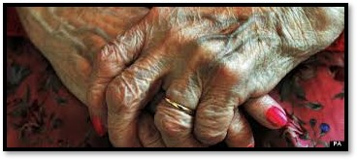
Provide Information on Coping
“Its normal to feel this way…..”
Notes:
The healing process begins by acknowledging the stress and feelings that are a normal response to it.

Slide 27
Common Stress Reactions Following Disaster Events
Behavioral/Emotional
Physical/Cognitive
Disorientation/numbness
Grief
Feeling anxious and fearful
Despair/hopelessness
Feelings of guilt
Feelings of anger
Isolation/withdrawl
Headaches, stomach aches
Difficulty sleeping/eating
Exhaustion
Bad dreams
Intrusive thoughts/images
Difficulty concentrating, remembering, making decisions
Notes:
These are summarized from the chart on slide 7 and the handout in this training packet.

Slide 28
EXPLAIN THAT THESE FEELINGS ARE NORMAL
DO SAY
“You are not going crazy”
“These kinds of reactions are normal after going through something like this”
“I have some suggestions for techniques to help you feel more calm. Would you like to hear them?”
DON”T SAY
“You should be feeling better tomorrow”
“Cheer up”
“Maybe you better see a doctor”
“What you need is…..”
“I know what it is like”
Notes:
Encourage the survivor to share these feelings and thoughts. Don’t judge or try to fix. Listen and reassure

Slide 29
Coping Techniques To Suggest
Deep slow breaths
Focus on inhale/exhale
Write in a journal
Talk to friends/loved ones
Stretch exercises
Listen to music
Reach out for spiritual support
Warm bath or shower
Make a list of recovery actions
Maintain a healthy routine
Rest
Eat well
Drink fluids
Exercise
Avoid drugs, alcohol, or binge eating
Set a small goal for each day related to recovery actions and check off list when done
Notes:
Ask the survivor what activities they do to relax and suggest this as another way to cope with intense negative feelings.

Slide 30
Link to Collaborative Services
Help survivors connect to services related to their needs
Medical
Financial
Spiritual
Recovery/replacement assistance related to loss
Remember that for most people, PFA is enough
Recognize those who need professional help with stress by using the “3 Rs”
Notes:
In the SNF setting this may be reporting to the nurse, social services director or the trusted family member. In the community it may be a service agency, a clergy or the Red Cross

Slide 31
MODULE 2 QUIZ
The purpose of PFA is to:
Prepare you to treat injuries after a disaster.
Enable you to persuade someone not to harm themselves after a disaster.
Enable to you to provide comfort, care and support to survivors of disasters.
None of the above.
2. Normal survivors are able to function just fine once the disaster is over and they are safe.
True/False
Notes:
Key
c.
False

Slide 32
QUIZ Module 2 (cont.)
3. What are some examples of effective coping techniques?
Rest sufficiently, eat well, drink fluids
Keep feelings to yourself, avoid friends and loved ones
Focus on slow, deep breaths
Have a few alcoholic beverages
a and c.
Notes:
Key
3. e.

Slide 33
PRACTICING PSYCHOLOGICAL FIRST AID
MODULE 3
Notes:
Instructors note.
This section is set up to do with a group but could be done individually with a student practicing the helper role while the instructor plays the survivor

Slide 34
DO’S AND DON’TS
BODY LANGUAGE
DO
Sit facing the person or beside
Give eye contact
Show attention by leaning forward
DON’T
Sit back with folded arms
Look around distractedly while person is talking
Leave while they are talking to you
Notes:
Have students partner up or have a volunteer come to the front of the class.
One will demonstrate the “do” and “don’t body language and when another student trying to talk to them. Ask them why this is important especially when trying to work with someone who is in distress.

Slide 35
DO’S AND DON’Ts
What to Say
Do say
Can we talk about what happened?
This must be difficult for you.
Is there anything I can do for you right now?
Its normal to feel this way after something like that.
I am here to help you if I can.
Notes:
Have students practice these phases in a gentle, respectful tone.

Slide 36
DO’S AND DON’TS
What NOT to say
I know what you are going through.
Don’t feel so bad.
You are strong and will get through this.
Don’t cry, cheer up.
Its God’s will.
It could have been worse.
Notes:
Help students to understand that these phases could inhibit the communication with a survivor instead of making them feel better. People in pain may feel like you could not possibly know what they are experiencing and feel like their suffering is being minimized. They also could feel like they shouldn’t be feeling the way they are when told that they are strong and that others have gone through worse.

Slide 37
LEARNING ACTIVITY – ROLE PLAY
PICK A PARTNER
ONE IS SURVIVOR AND ONE IS HELPER
SWITCH ROLES FOR ROLE PLAY #2
PRACTICE THE TECHNIQUES YOU HAVE LEARNED
Notes:
These role plays could be done by partners in a class or by two volunteers performing in front of the class. The object is to get them to practice the techniques so that they feel more comfortable.

Slide 38
ROLE PLAY #1
This morning there was an earthquake that shook things off shelves, caused the fire sprinklers to go off, and knocked out the power to your facility. Several hours have passed and things have settled down but it is starting to get dark. You notice one of the alert female residents wandering around the halls and refusing to go into her room. Practice the principles of PFA to calm and reassure this person.
Notes:
Look for appropriate body language, communication techniques, and the core actions of:
Making the connection
Providing safety and comfort
Stabilization
Info gathering
Practical assistance
Connection to social supports
Info on coping
Linking to collaborative services

Slide 39
ROLE PLAY #2
There was a fire at a nearby nursing home that killed two residents and forced all to evacuate. Your facility has accepted five emergency admits from the burned facility. One of these admits is a male resident whose roommate was killed in the fire. You see him in his wheelchair in the corner of the dining room weeping quietly and muttering to himself. Practice the principles of PFA to calm and comfort him.
A few minutes into the conversation he tells you “I can’t take all this trouble anymore. I just want to die”.
What is your next step?
Notes:
In addition to the core actions, look for a referral to professional help asap. In the SNF this would be at a minimum getting a nurse. Remember not to leave the person alone but to send someone, or ask someone to sit with the resident while the helper goes for help.

Slide 40
Additional PFA Resources
National Child Traumatic Stress Network https://learn.nctsn.org/course/index.php?categoryid=11
Minnesota Dept of Health http://www.health.state.mn.us/oep/responsesystems/pfa.html
John Hopkins University via Coursera https://www.class-central.com/course/coursera-psychological-first-aid-2900

Slide 41
Disaster Mental Health Services
Contact List for California County Mental Health Departments https://www.dhcs.ca.gov/individuals/Pages/MHPContactList.aspx
Disaster Distress Helpline SAMHSA 1 800-985-5590 http://disasterdistress.samhsa.gov
American Red Cross 1 800-RED CROSS

Slide 42
Questions?
Regarding this presentation:
Jocelyn Montgomery, PHN
jocelynmontgomery@gmail.com
Regarding Continuing Education:
Cortney Kesterson, CAHF-DPP Coordinator
ckesterson@cahf.org

